Slide 1
MIPS
Instruction Set Architecture
19CSE211 COA
Session 6
21-01-2021

Slide 2
Recap of Session 5
H.C. TD5102

Slide 3
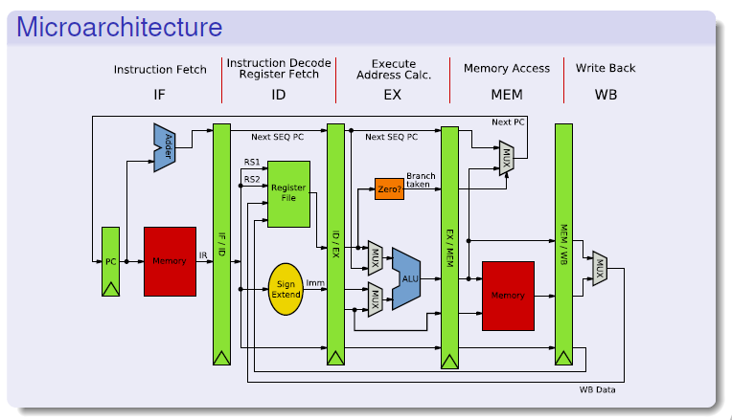
H.C. TD5102

Slide 4
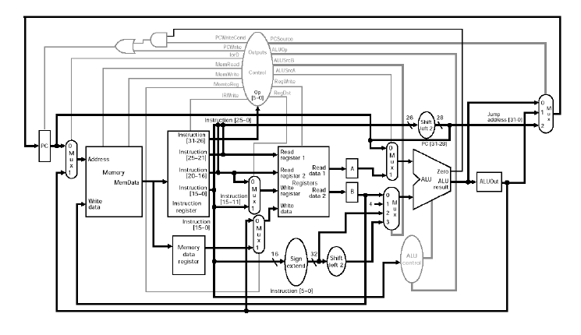
MIPS Data path with Control Signals
H.C. TD5102

Slide 5
MIPS - ISA
H.C. TD5102

Slide 6
Main Types of Instructions
Arithmetic
  Integer
  Floating Point
Memory access instructions
  Load & Store
Control flow
  Jump
  Conditional Branch
  Call & Return
H.C. TD5102

Slide 7
MIPS arithmetic
Most instructions have 3 operands
Operand order is fixed (destination first)
Example:
C code: A = B + C
MIPS code: ????????????
H.C. TD5102

Slide 8
MIPS arithmetic
Most instructions have 3 operands
Operand order is fixed (destination first)
Example:
C code: A = B + C
MIPS code: add $s0, $s1, $s2
($s0, $s1 and $s2 are associated with variables by compiler)
H.C. TD5102

Slide 9
MIPS arithmetic
C code: A = B + C + D;
E = F - A;
MIPS code: ???????
Operands must be registers, only 32 registers provided
H.C. TD5102

Slide 10
MIPS arithmetic
C code: A = B + C + D;
E = F - A;
MIPS code: add $t0, $s1, $s2
add $s0, $t0, $s3
sub $s4, $s5, $s0
Operands must be registers, only 32 registers provided
Design Principle: smaller is faster. Why?
H.C. TD5102

Slide 11
Registers vs. Memory
Arithmetic instruction operands must be registers,
— only 32 registers provided
Compiler associates variables with registers
What about programs with lots of variables ?
Memory
CPU
register file
IO
H.C. TD5102

Slide 12
Register allocation
Compiler tries to keep as many variables in registers as possible
Some variables can not be allocated
  large arrays (too few registers)
  aliased variables (variables accessible through pointers in C)
  dynamic allocated variables
    heap
    stack
Compiler may run out of registers => spilling
H.C. TD5102

Slide 13
Memory Organization
Viewed as a large, single-dimension array, with an address
A memory address is an index into the array
"Byte addressing" means that successive addresses are one byte apart
0
8 bits of data
1
8 bits of data
2
8 bits of data
3
8 bits of data
4
8 bits of data
5
8 bits of data
6
8 bits of data
...
H.C. TD5102

Slide 14
Memory Organization
Bytes are nice, but most data items use larger "words"
For MIPS, a word is 32 bits or 4 bytes.
2³² bytes with byte addresses from 0 to 2³²-1
2³⁰ words with byte addresses 0, 4, 8, ... 2³²-4
0
32 bits of data
4
Registers hold 32 bits of data
32 bits of data
8
32 bits of data
...
12
32 bits of data
H.C. TD5102

Slide 15
Memory layout: Alignment
31
23
15
7
0
0
this word is aligned; the others are not!
4
8
12
address
16
20
24
Words are aligned
What are the least 2 significant bits of a word address?
H.C. TD5102

Slide 16
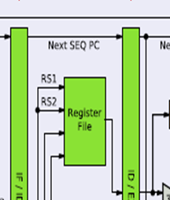
What about Register file ???
H.C. TD5102

Slide 17
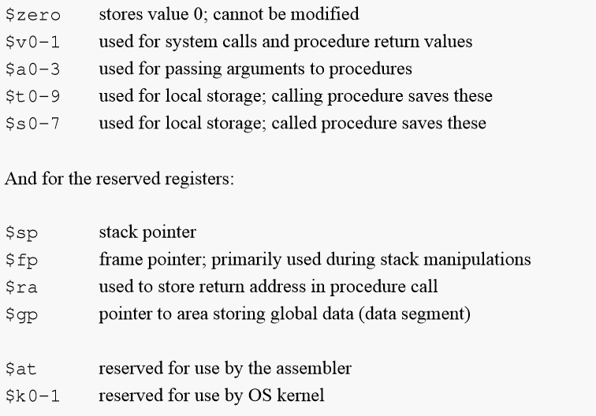
Used MIPS Conventions
32 Registers each of 32 bits
H.C. TD5102

Slide 18
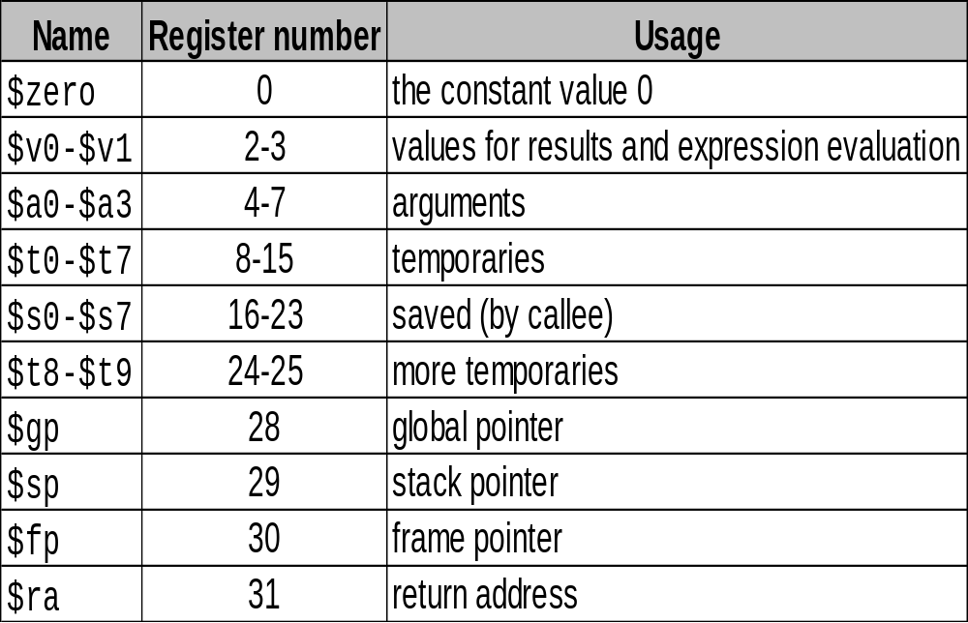
Used MIPS Conventions
$at – Reg No 1 – Reserved for Assembler
$k0, $k1 – Reserved for Operating System
H.C. TD5102

Slide 19
Addressing Modes
Addressing modes are an aspect of the instruction set architecture in most CPU designs.
The various addressing modes that are defined in a given instruction set architecture define how the machine language instructions in that architecture identify the operand(s) of each instruction.
An addressing mode specifies how to calculate the effective memory address of an operand by using information held in registers and/or constants contained within a machine instruction or elsewhere.
In computer programming, addressing modes are primarily of interest to those who write in assembly languages and to compiler writers.
H.C. TD5102

Slide 20
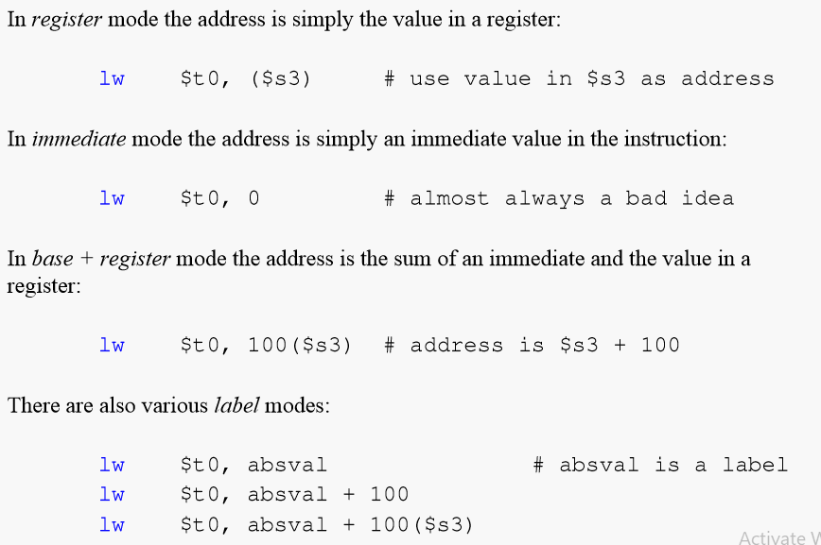
H.C. TD5102

Slide 21
Instructions
Load and store instructions
Example:
C code: A[8] = h + A[8];
MIPS code: ????
Store word operation has no destination (reg) operand
Remember arithmetic operands are registers, not memory!
H.C. TD5102

Slide 22
Instructions
Load and store instructions
Example:
C code: A[8] = h + A[8];
MIPS code: lw $t0, 32($s3)
add $t0, $s2, $t0
sw $t0, 32($s3)
Store word operation has no destination (reg) operand
Remember arithmetic operands are registers, not memory!
H.C. TD5102

Slide 23
So far we’ve learned:
MIPS
— loading words but addressing bytes
— arithmetic on registers only
Instruction Meaning
add $s1, $s2, $s3 $s1 = $s2 + $s3
sub $s1, $s2, $s3 $s1 = $s2 – $s3
lw $s1, 100($s2) $s1 = Memory[$s2+100]
sw $s1, 100($s2) Memory[$s2+100] = $s1
H.C. TD5102

Slide 24
Machine Language
Instructions, like registers and words of data, are also 32 bits long
  Example: add $t0, $s1, $s2
  Registers have numbers: $t0=9, $s1=17, $s2=18
Instruction Format:
op rs rt rd shamt funct
000000 10001 10010 01000 00000 100000
6 bits
5 bits
5 bits
5 bits
5 bits
6 bits
H.C. TD5102

Slide 25
Machine Language
Consider the load-word and store-word instructions,
  What would the regularity principle have us do?
  New principle: Good design demands a compromise
Introduce a new type of instruction format
  I-type for data transfer instructions
  other format was R-type for register
Example: lw $t0, 32($s2)
35 18 9 32
op rs rt 16 bit number
H.C. TD5102

Slide 26
Stored Program Concept
memory
OS
code
global data
stack
heap
Program 1
CPU
unused
Program 2
unused
H.C. TD5102

Slide 27
Control
Decision making instructions
  alter the control flow,
  i.e., change the "next" instruction to be executed
MIPS conditional branch instructions:
bne $t0, $t1, Label
beq $t0, $t1, Label
Example: if (i==j) h = i + j;
bne $s0, $s1, Label
add $s3, $s0, $s1
Label: ....
H.C. TD5102

Slide 28
Control
MIPS unconditional branch instructions:
j label
Example:
if (i!=j) beq $s4, $s5, Lab1
h=i+j; add $s3, $s4, $s5
else j Lab2
h=i-j; Lab1: sub $s3, $s4, $s5
Lab2: ...
Can you build a simple for loop?
H.C. TD5102

Slide 29
So far:
Instruction Meaning
add $s1,$s2,$s3 $s1 = $s2 + $s3
sub $s1,$s2,$s3 $s1 = $s2 – $s3
lw $s1,100($s2) $s1 = Memory[$s2+100]
sw $s1,100($s2) Memory[$s2+100] = $s1
bne $s4,$s5,L Next instr. is at Label if $s4 ° $s5
beq $s4,$s5,L Next instr. is at Label if $s4 = $s5
j Label Next instr. is at Label
Formats:
op rs rt rd shamt funct
R
I
J
op rs rt 16 bit address
op 26 bit address
H.C. TD5102

Slide 30
Control Flow
We have: beq, bne, what about Branch-if-less-than?
New instruction:
if $s1 < $s2 then
$t0 = 1
slt $t0, $s1, $s2 else
$t0 = 0
Can use this instruction to build "blt $s1, $s2, Label"
— can now build general control structures
Note that the assembler needs a register to do this,
— use conventions for registers
H.C. TD5102

Slide 31
Constants
Small constants are used quite frequently (50% of operands) e.g., A = A + 5;
B = B + 1;
C = C - 18;
Solutions? Why not?
  put 'typical constants' in memory and load them
  create hard-wired registers (like $zero) for constants like one
  or …….
MIPS Instructions:
addi $29, $29, 4
slti $8, $18, 10
andi $29, $29, 6
ori $29, $29, 4
H.C. TD5102
3

Slide 32
How about larger constants?
We'd like to be able to load a 32 bit constant into a register
Must use two instructions; new "load upper immediate" instruction
lui $t0, 1010101010101010
filled with zeros
1010101010101010
0000000000000000
Then must get the lower order bits right, i.e.,
ori $t0, $t0, 1010101010101010
1010101010101010
0000000000000000
0000000000000000
1010101010101010
ori
1010101010101010
1010101010101010
H.C. TD5102

Slide 33
Assembly Language vs. Machine Language
Assembly provides convenient symbolic representation
  much easier than writing down numbers
  e.g., destination first
Machine language is the underlying reality
  e.g., destination is no longer first
Assembly can provide 'pseudoinstructions'
  e.g., “move $t0, $t1” exists only in Assembly
  would be implemented using “add $t0,$t1,$zero”
When considering performance you should count real instructions
H.C. TD5102

Slide 34
Overview of MIPS
simple instructions all 32 bits wide
very structured, no unnecessary baggage
only three instruction formats
rely on compiler to achieve performance
— what are the compiler's goals?
help compiler where we can
op rs rt rd shamt funct
R
I
J
op rs rt 16 bit address
op 26 bit address
H.C. TD5102

Slide 35
Addresses in Branches and Jumps
Instructions:
  bne $t4,$t5,Label Next instruction is at Label if $t4 ≠ $t5
  beq $t4,$t5,Label Next instruction is at Label if $t4 = $t5
  j Label Next instruction is at Label
Formats:
Addresses are not 32 bits
— How do we handle this with load and store instructions?
op rs rt 16 bit address
I
J
op 26 bit address
H.C. TD5102

Slide 36
Addresses in Branches
Instructions:
  bne $t4,$t5,Label Next instruction is at Label if $t4 ≠ $t5
  beq $t4,$t5,Label Next instruction is at Label if $t4 = $t5
Formats:
Could specify a register (like lw and sw) and add it to address
  use Instruction Address Register (PC = program counter)
  most branches are local (principle of locality)
Jump instructions just use high order bits of PC
  address boundaries of 256 MB
op rs rt 16 bit address
I
H.C. TD5102

Slide 37
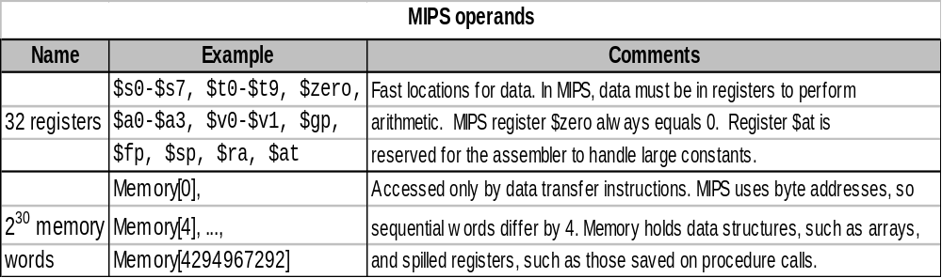
To summarize:
H.C. TD5102

Slide 38
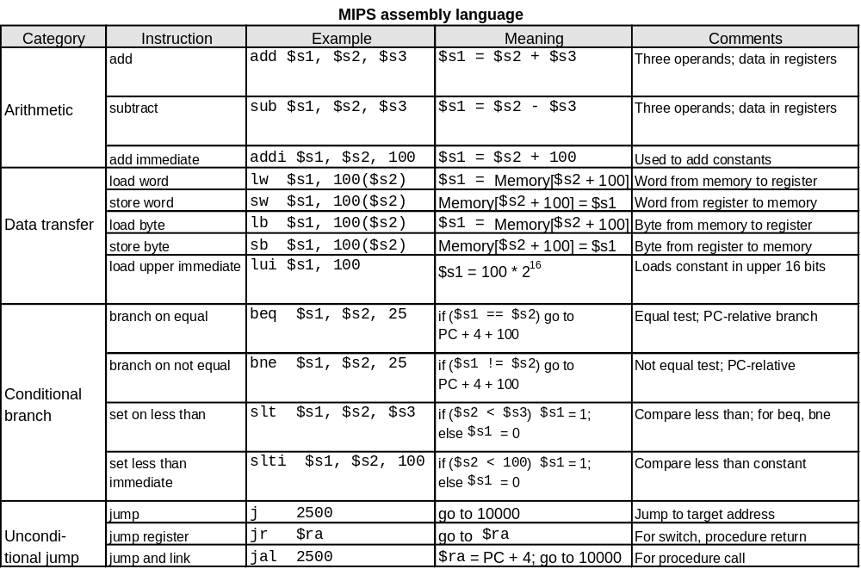
To summarize:
H.C. TD5102

Slide 39
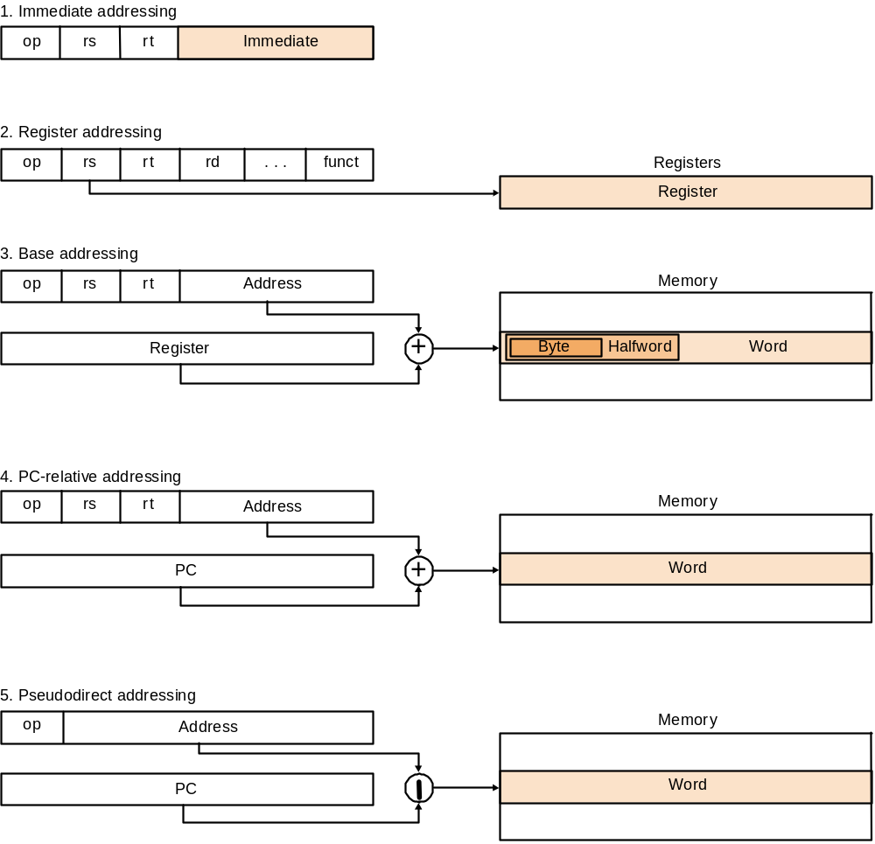
MIPS addressing modes summary
H.C. TD5102

Slide 40
Other Issues
Things not yet covered:
  support for procedures
  linkers, loaders, memory layout
  stacks, frames, recursion
  manipulating strings and pointers
  interrupts and exceptions
  system calls and conventions
We've focused on architectural issues
  basics of MIPS assembly language and machine code
  we’ll build a processor to execute these instructions
H.C. TD5102

Slide 41

Our First C Example
Can we figure out the code?
swap(int v[], int k);
{ int temp;
temp = v[k]
v[k] = v[k+1];
v[k+1] = temp;
}
swap:
muli $2 , $5, 4
add $2 , $4, $2
lw $15, 0($2)
lw $16, 4($2)
sw $16, 0($2)
sw $15, 4($2)
jr $31
Explanation:
index k : $5
base address of v: $4
address of v[k] is $4 + 4.$5
H.C. TD5102

Slide 42
MIPS
Instruction Set Architecture
Courtesy: Henk Corporaal
http://www.ics.ele.tue.nl/~heco/courses/EmbSystems
Technical University Eindhoven
DTI / NUS Singapore

